Slide 1
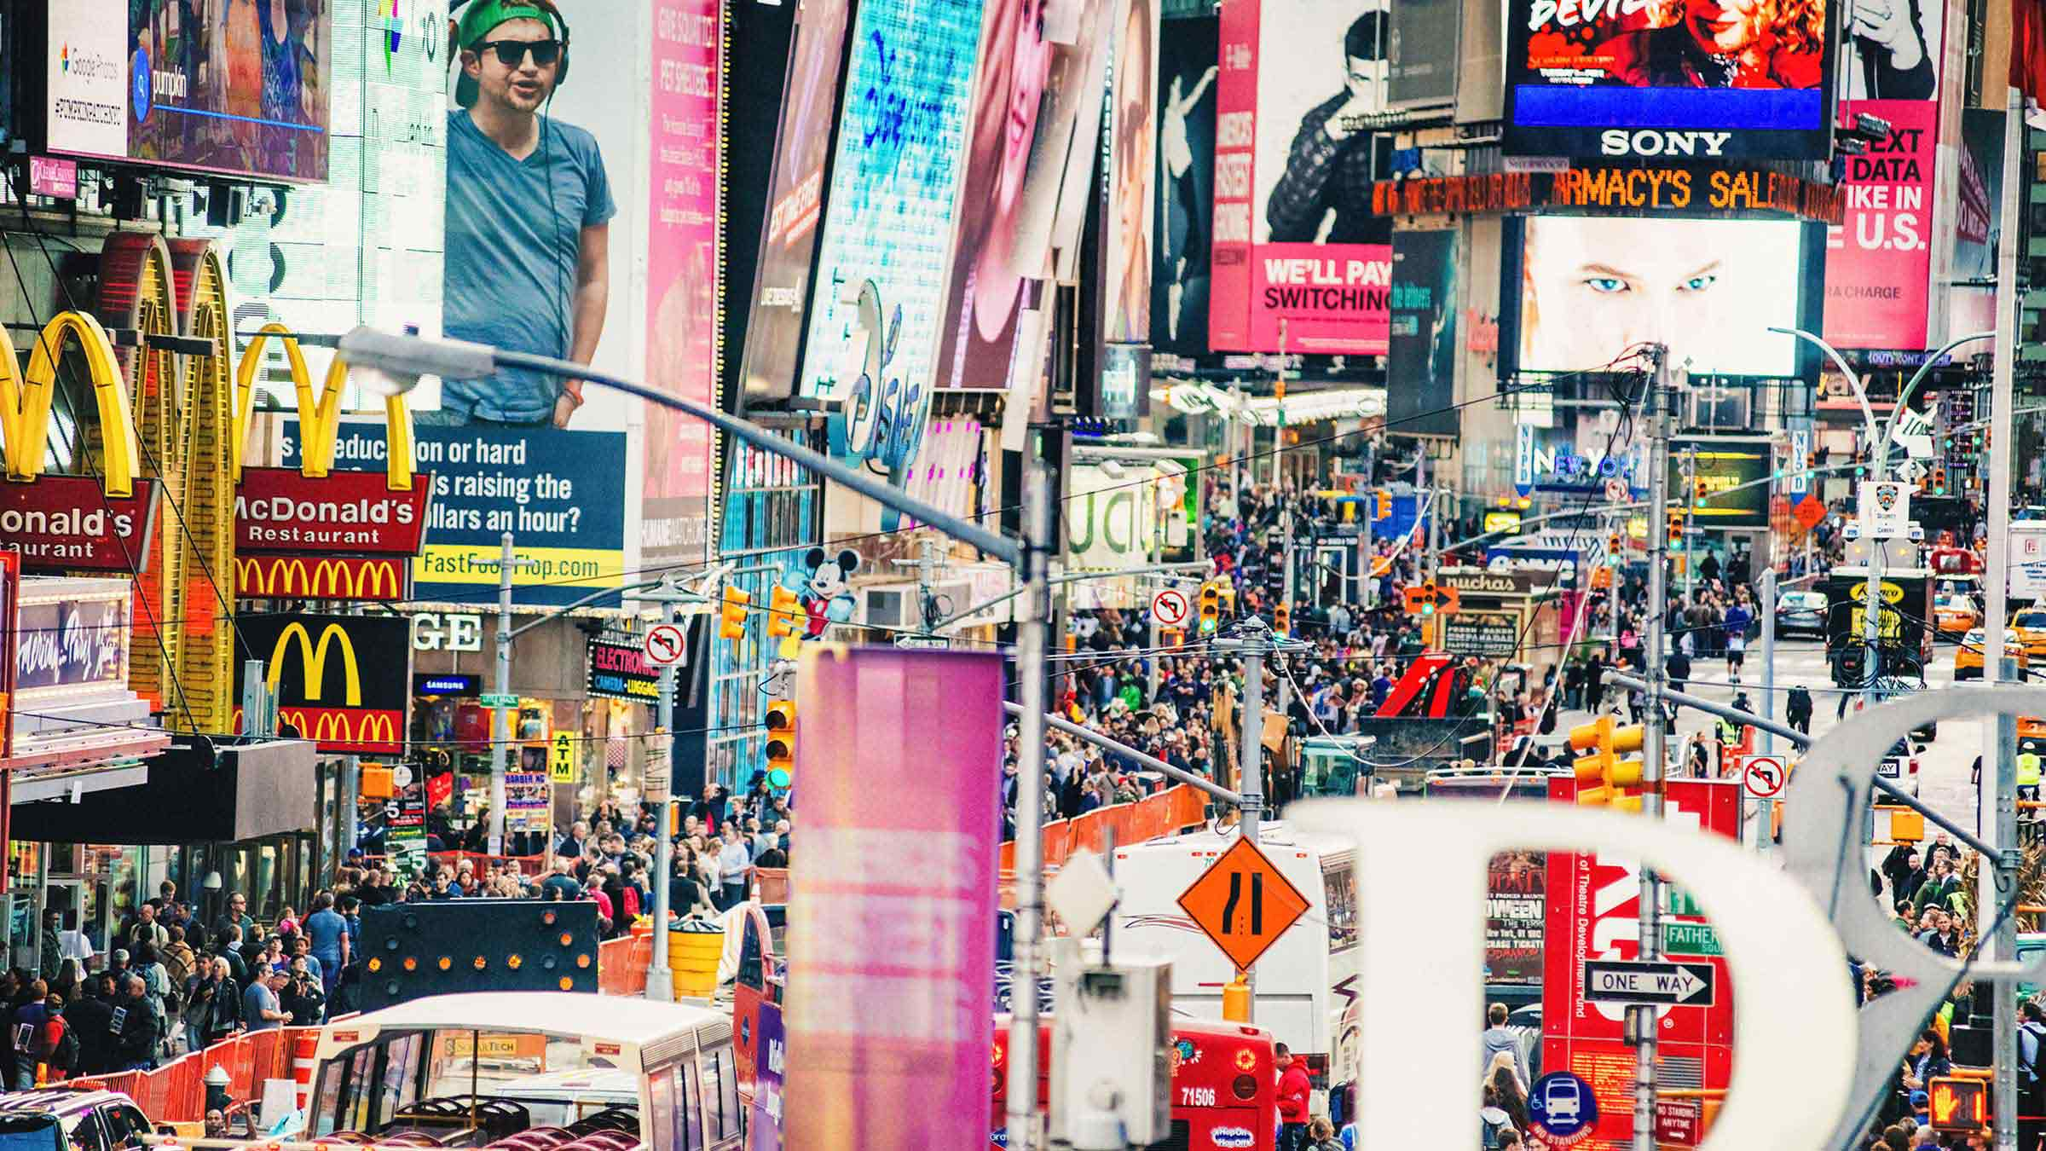
The Number One Problem in Our Country Begs For a Pragmatic and Ethical Political Solution
Inside: Insights on America's deep polarization and inequality and the urgent need for solutions:
The case for a third political party

Slide 2
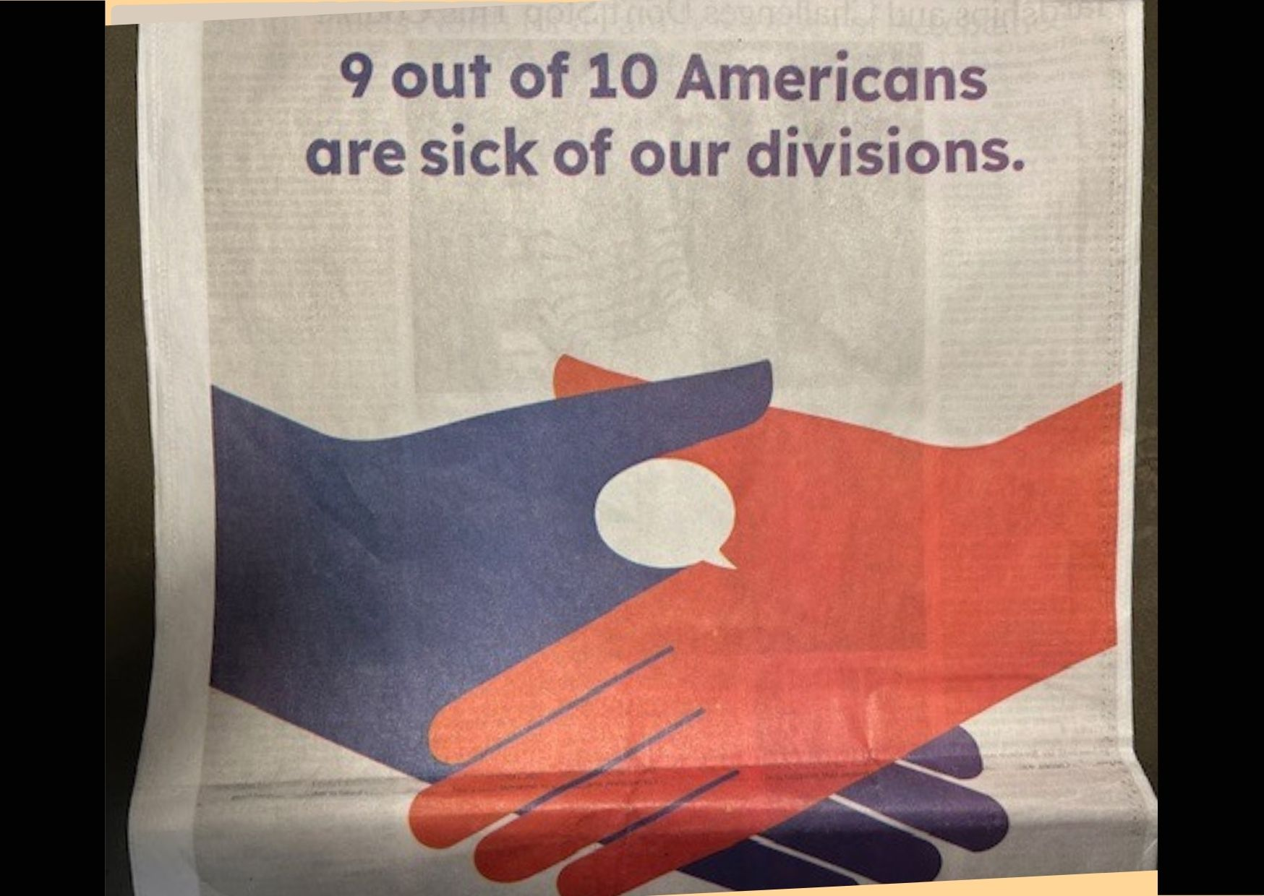

Slide 3
Barack Obama: “The degree of polarization that currently exists in Washington is such where I think it's fair to say if I presented a cure for cancer, getting legislation passed to move that forward would be a nail-biter.”
Jonathan Van Ness: “From the extreme political polarization that is everywhere - there's so much suffering going on - so many people are really thirsty to feel good about something.”
Pete Gallego: “As the polarization in D.C. spreads, the people willing to come to the middle find less and less acceptance.”
Carl Sagan: “The chief deficiency I see in the skeptical movement is its polarization: Us vs. Them - the sense that we have a monopoly on the truth; that those other people who believe in all these patterns are morons. This is nonconstructive. It does not get our message across. It condemns us to permanent minority status.”
George Saunders: "I think in our time, you know, so much of the information we get is pre-polarized. Fiction has a way of reminding us that we actually are very similar in our emotions and our neurology and our desires and our fears, so I think it’s a nice way to neutralize that polarization."

Slide 4
THE FINAL ANSWER TO AMERICA'S CONFUSION AND POLITICAL MALAISE
"I don't consider myself a Republican. I don't consider myself a Democrat either. I consider myself an American. I'm a human being and there's a lot of things that the Democrats believe that I believe," said podcaster Joe Rogen.
Rogan recently reiterated his belief in evaluating ideas based on their merit rather than their source. Rogan's stance criticizes the polarization that comes with strict party loyalty.
"There's a lot of things that they say that I say, that makes a lot of sense to me, and there's a lot of things that the Republicans say [where] I say, that makes a lot of sense to me too. And the idea that I have to ignore things that make sense to me because it's coming from the wrong team is just stupid," he continued.
Rogan's comments continue to spark debate among his listeners and critics, reflecting the broader conversation about political identity and the challenges of navigating a deeply divided political landscape.
THE ANSWER TO OUR NATION'S BIGGEST PROBLEM: A NEW PARTY THAT MAKES SENSE TO EVERYONE

Slide 5
UrbaNaturalism describes a postmodern macrotrend that acts symbolically, like an elevator platform that lifts us up to a broader schema, a way to "fly higher," a way to think and plan differently, a way to step up and away from time-wasting divisiveness that is no longer relevant in this new era which depends upon Gen Y and Z to get things done.
Again, an UrbaNatural political party would take us beyond what we have to who we are and what we do; the UrbaNatural movement would move us from the acquisition of things to the enhancement of the self.
There is an answer to this deep-seated confusion and rejection of both Republican and Democrat political stances. The answer is built upon a new word that is more inclusive, more understandable, more symbolic and more inspirational: "UrbaNaturalism"….yes, this is the fusionary word that brings opposites together. A new word that symbolizes togetherness and true unity. It reminds us of the importance of synthesis and interconnectedness in our current tech-driven, network culture.

Slide 6
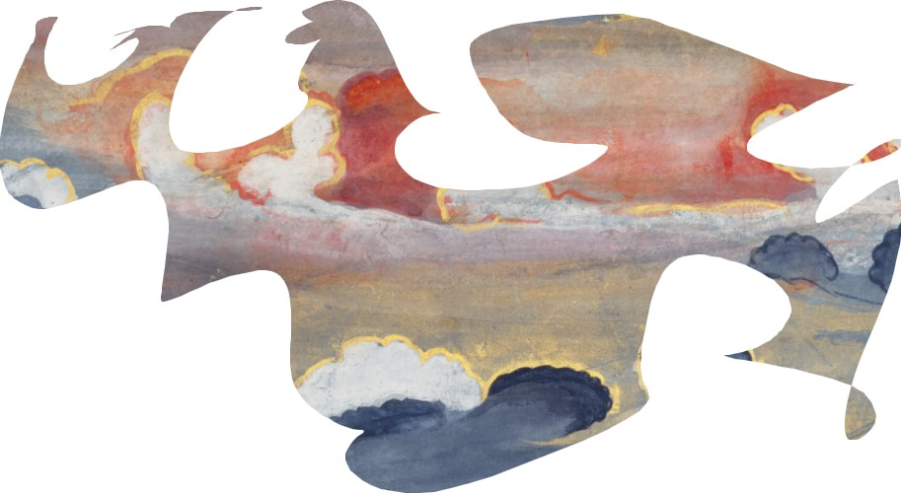
“UrbaNatural” is obviously a combination word that exists to blend knowledge even among voters that have very different backgrounds. UrbaNaturalism addresses the increasing scale and interconnectedness of the human problem. The UrbaNatural Party will be suited to deal with the complex, diffuse processes of social change.
The UrbaNatural Party will offset an over-emphasis on materialism and individualism, two qualities that, when taken together and too far, reduce social integration, self-worth and moral clarity. We've moved away from being citizens to being consumers. There has been a reduction of social integration, self worth and existential confidence.
Again, an UrbaNatural political party would take us beyond what we have to who we are and what we do; the UrbaNatural movement would move us from the acquisition of things to the enhancement of the self. The UrbaNatural party would create new understanding by integrating existing knowledge from across a range fields, disciplines and sciences. The focus of UrbaNatural discussions would develop new, common frameworks of understanding, striving for coherence in the overall conceptual picture rather than emphasizing precise detail.

Slide 7
The "either-or' mentality that accompanies the choice between being a Democrat or Republican focuses Americans on doing things that shift us away from intrinsic to extrinsic values. The result is an increasing focus on our own lives and an unrelenting need to make the most of life.
Americans have become consumers first and foremost, not citizens. Status, money, recognition and other rewards are foremost in our culture. As a result, frustration, anger, loneliness and depression are at greater risk.
The UrbaNatural Party will remind us that we are all branches on the same tree.
If you doubt this, just ask the typical worker in a production line why he and 70% of the rest of the workforce are looking for something more meaningful in their career. Most are poised to leave for fifty cents more per hour. Until then, there is pervasive malaise. ("We pretend to work…they pretend to pay us.")
The "either-or' mentality that accompanies the choice between being a Democrat or Republican focuses Americans on doing things that shift us away from intrinsic to extrinsic values. The result is an increasing focus on our own lives and an unrelenting need to make the most of life. Frustration, anger, loneliness and depression are at greater risk. Americans have become consumers first and foremost, not citizens. Status, money, recognition and other rewards are foremost in our culture.

Slide 8
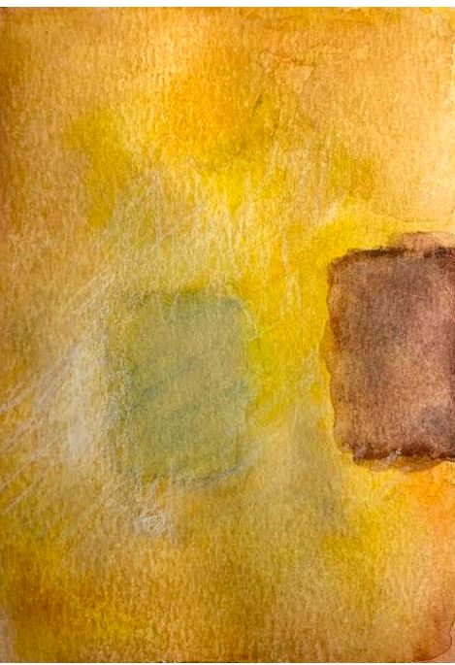
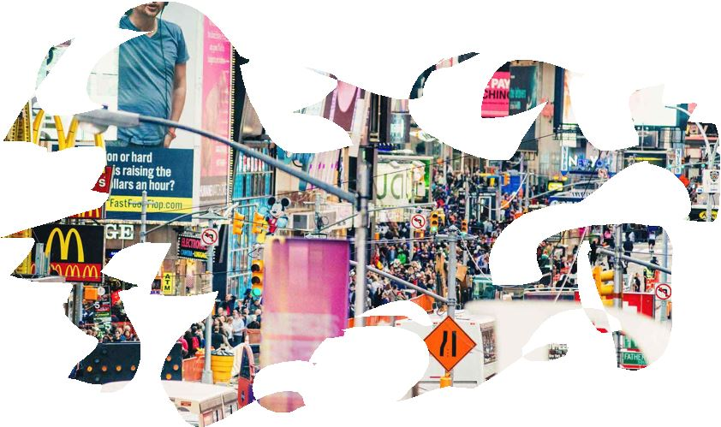
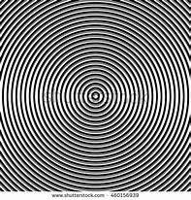
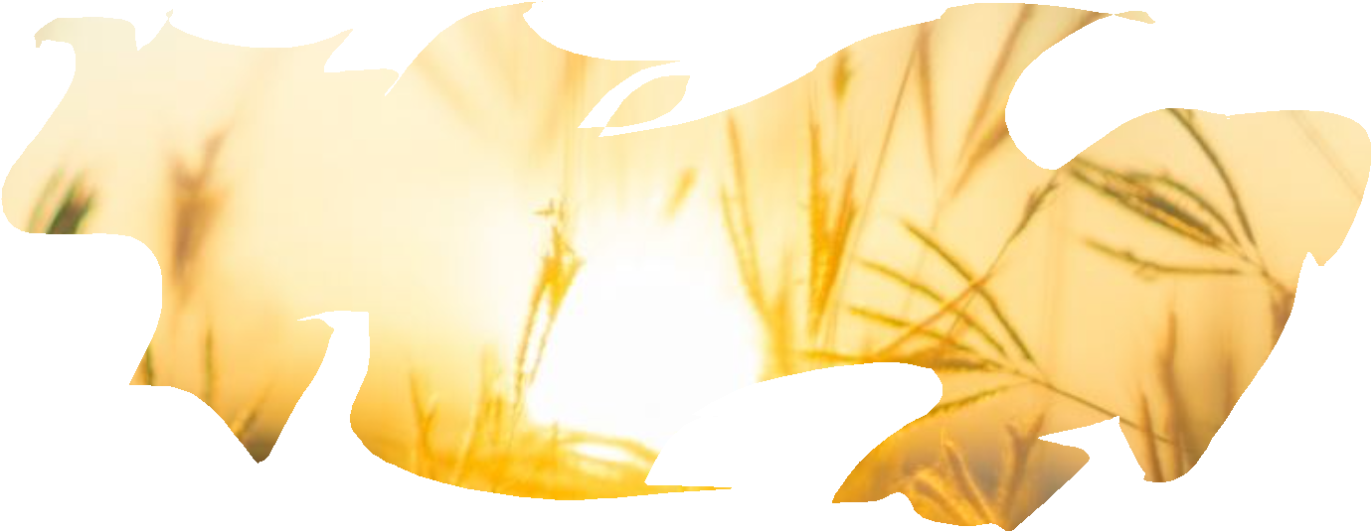
If you agree that it’s time for the UrbaNatural Party to emerge, contact Lynn Hinderaker: lynn@newbraska.com
Speeches, seminars and workshops are available.

